Slide 1

Deep Neural Network: Recurrent Neural Network (RNN)
Mina Farmanbar
Associate Professor, University of Stavanger
for engineers

Slide 2
Recurrent Neural Network (RNN)
Recurrent neural network is called RNN for short.
They are networks with loops.
They don't just take a new input at a time, but also take in as input the output from the previous data point that was fed into the network.
A RNN has short-term memory that allows the network to retain past information and, hence, uncover relationships between data points that are far from each other.

Slide 3
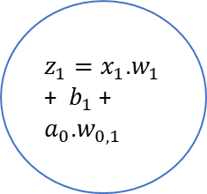
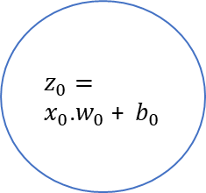
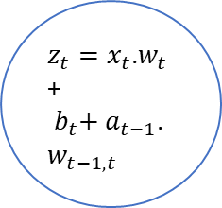
Recurrent Neural Network (RNN)
Hidden State
and acts as “memory” of the network
$$a_{1}=f(z_{1})$$
$$a_{t}=f(z_{t})$$
$$a_{0}=f(z_{0})$$
$$w_{0,1}$$
$$w_{0,1}$$
$$w_{t−1,t}$$
$z_{0}=x_{0}$.$w_{0}$ + ${ b}_{0}$
$z_{1}=x_{1}$.$w_{1}$ + ${ b}_{1}$ + $a_{0}$.$w_{0,1}$
$z_{t}=x_{t}$.$w_{t}$ + ${ b}_{t}+ a_{t−1}$.$w_{t−1,t}$
…
$b_{0}$
$b_{1}$
$w_{0}$
$w_{t}$
$b_{t}$
$w_{1}$
$x_{0}$
$x_{t}$
$x_{1}$

Slide 4
Recurrent Neural Network (RNN)
RNNs are great for handling time series and sequence data such as audio and text.
Video Analysis
Language Translation
Stock Market Predication
Chatbots
Virtual Assistants.
https://miro.medium.com/v2/resize:fit:640/format:webp/1*TqcA9EIUF-DGGTBhIx_qbQ.gif

Slide 5
Chatbot
Let’s say we want to build a chatbot and the chatbot can classify intentions from the users input text.
A user types in…
What time is it?

Slide 6
Chatbot
To start, we break up the sentence into individual words. RNN’s work sequentially. So, we feed it one word at a time.

Slide 7
Chatbot
Then the network feeds “What” into the RNN. The RNN encodes “What” and produces an output.
https://easyai.tech/en/ai-definition/rnn/

Slide 8
Chatbot
For the next step, we feed the word “time” and the hidden state from the previous step. The RNN now has information on both the word “What” and “time.”
https://easyai.tech/en/ai-definition/rnn/

Slide 9
Chatbot
We repeat this process, until the final step. You can see by the final step the RNN has encoded information from all the words in previous steps.
https://easyai.tech/en/ai-definition/rnn/

Slide 10
Chatbot
Since the final output was created from the rest of the sequence, we should be able to take the final output and pass it to the feed-forward layer to classify an intent.
https://easyai.tech/en/ai-definition/rnn/

Slide 11

Vanishing Gradient
You may have noticed the odd distribution of colors in the hidden states. That is to illustrate an issue with RNN’s known as short-term memory.
Final hidden state of the RNN
https://easyai.tech/en/ai-definition/rnn/

Slide 12
Vanishing Gradient
As you can see, the information from the word “what” and “time” is almost non-existent at the final time step.
The network then has to make the best guess with “is it?”.
Final hidden state of the RNN
https://easyai.tech/en/ai-definition/rnn/

Slide 13
Vanishing Gradient
Vanishing Gradient
Cause:
Gradients become very small during backpropagation.
Effect:
Early layers learn slowly, struggling with long-term dependencies.
Impact:
Poor performance on tasks needing long-term information.

Slide 14
Vanishing Gradient
Solution?
Long Short-Term Memory (LSTM)

Slide 15
Thank you!
Mina Farmanbar
mina.farmanbar@uis.no

